Slide 1
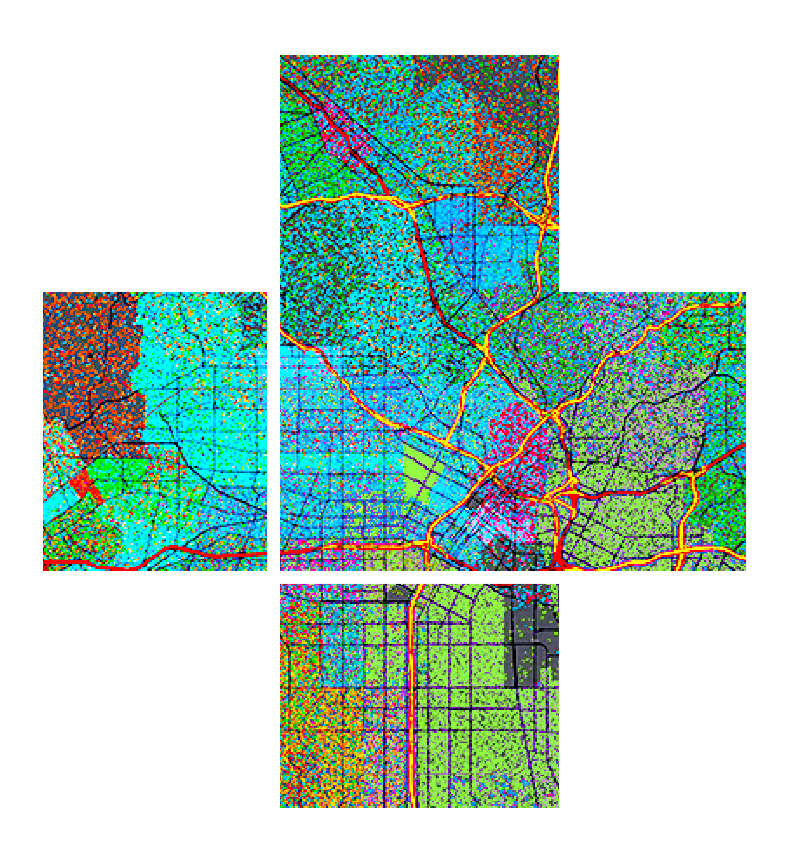








ArcGIS API for JavaScript: 2D Visualization
Please leave artwork “+” clustered.
Do not use them alone, as bullet points, or as a “plus” concept. Thank you.
Kristian Ekenes & Jeremy Bartley
2020 ESRI DEVELOPER SUMMIT | Palm Springs, CA

Slide 2


Discover how to visualize geodata in meaningful ways using the ArcGIS API for JavaScript
Notes:
Motivation – why are they here

Slide 3
One visualization cannot tell the whole story
Notes:
Motivation – why are they here

Slide 4
API Overview
Renderers, symbols, etc.

Slide 5
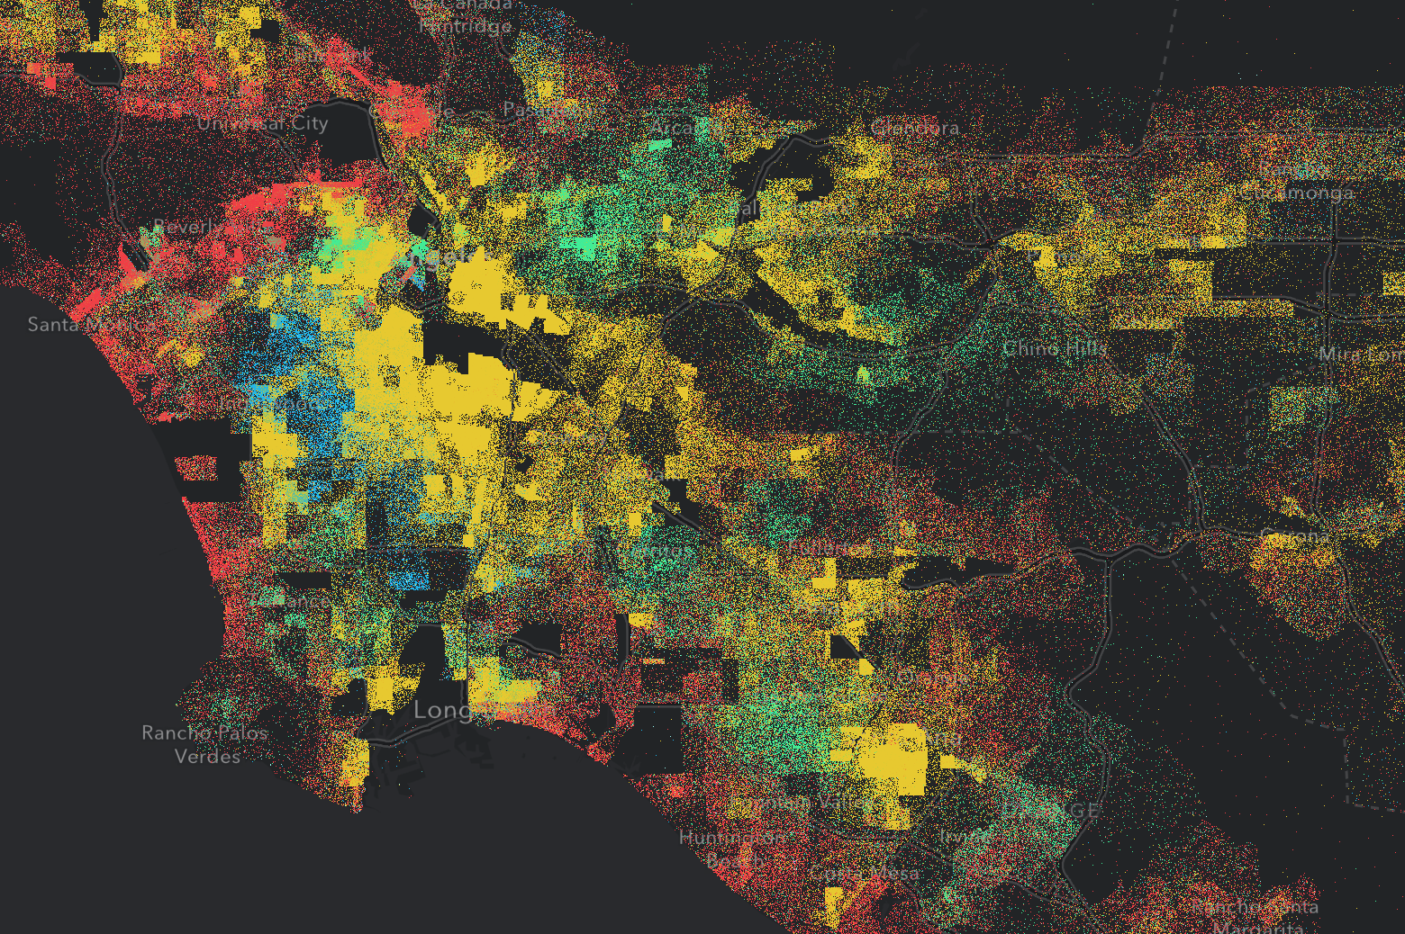
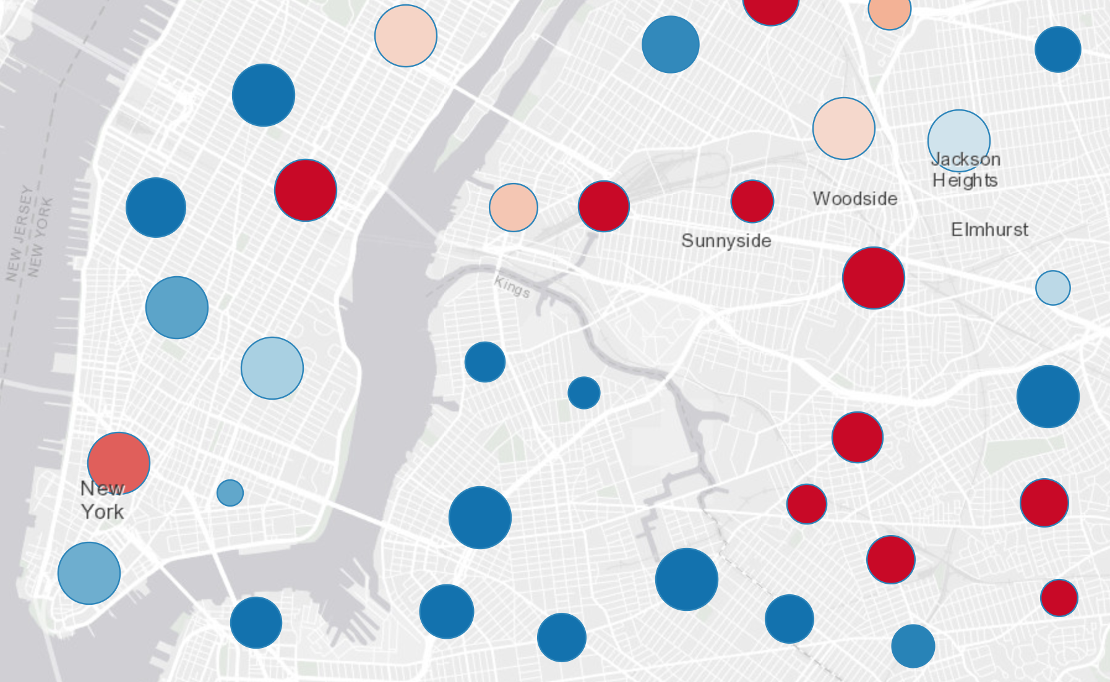
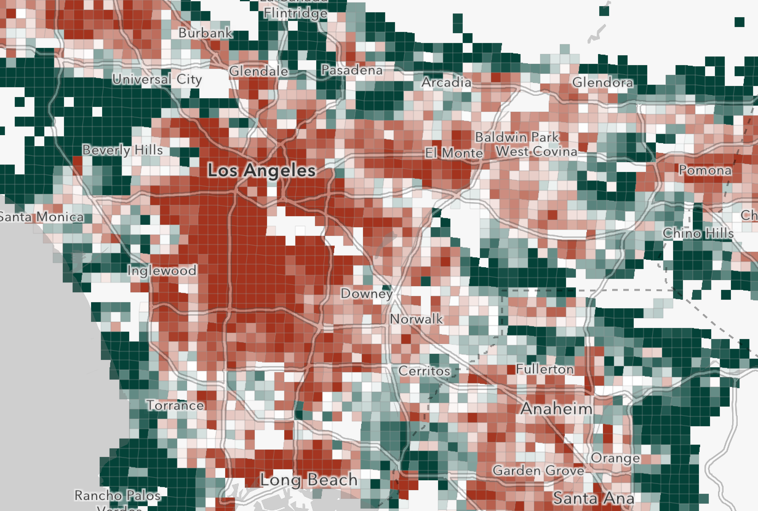
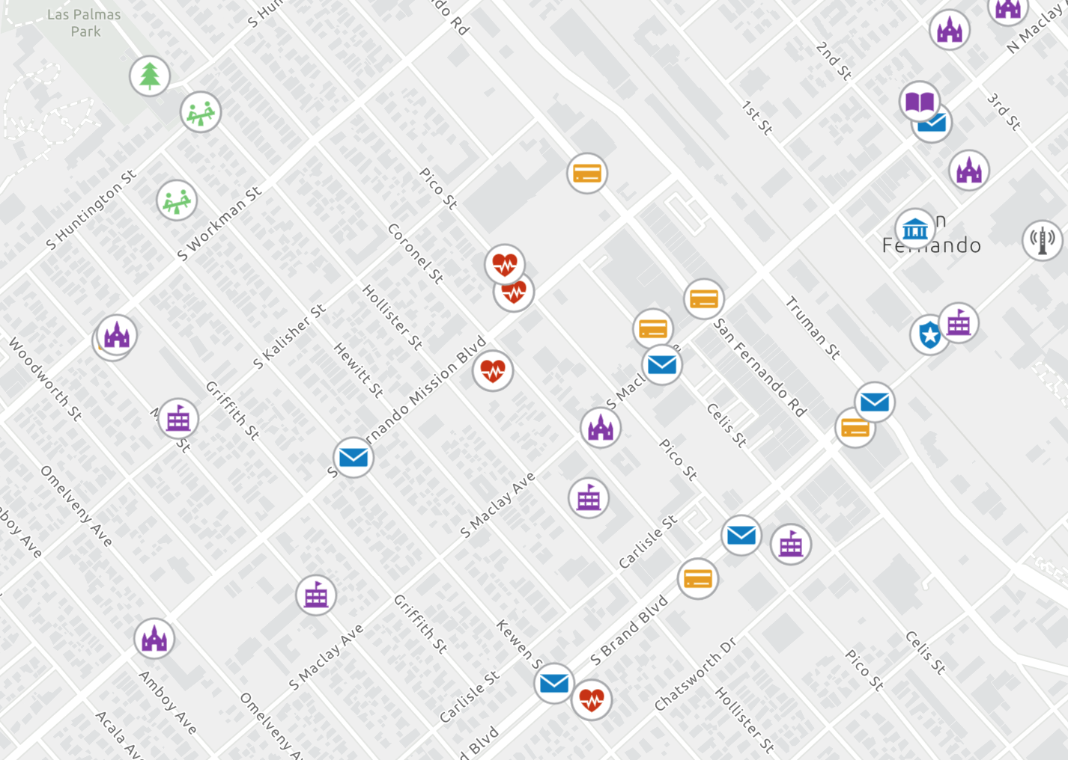
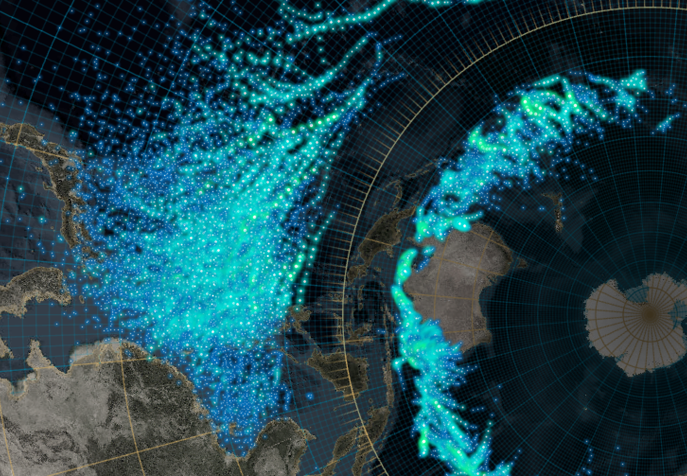

What can we visualize?
Where?
What?
How much?
When?
Multivariate

Slide 6
Symbols

Slide 7
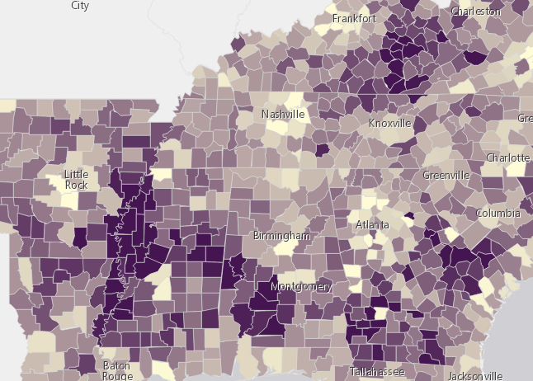
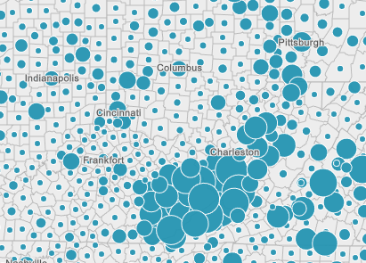


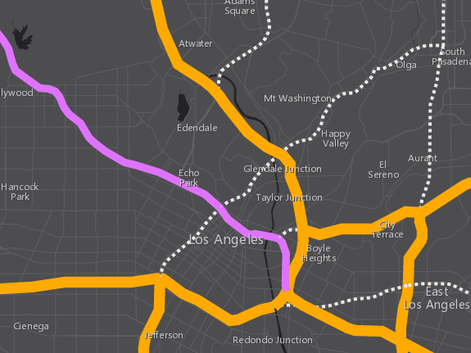
Symbols
SimpleFillSymbol
PictureFillSymbol
SimpleMarkerSymbol
PictureMarkerSymbol
WebStyleSymbol
CIMSymbol
SimpleLineSymbol
based on geometry type
Polygons
Points
Polylines

Slide 8
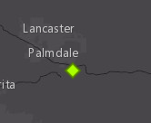
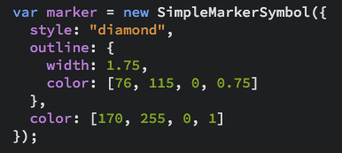
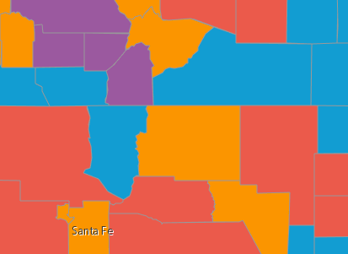
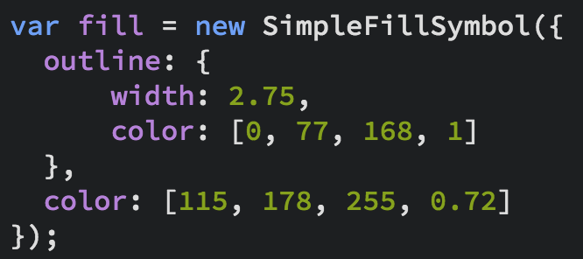
Symbols
Notes:
Show the playground here

Slide 9
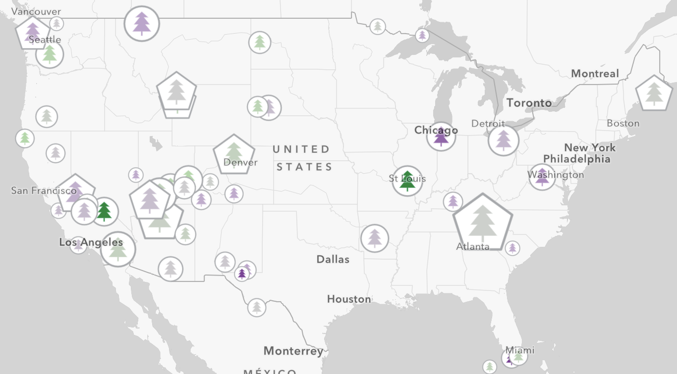
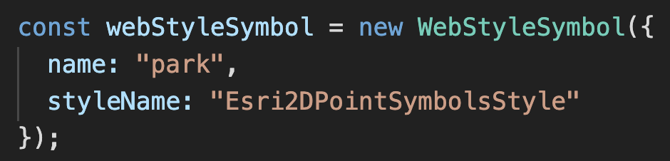
Web Style Symbols
2d styles
Cartographic Information Model (CIM)
Vectors
Scalable
Multi-layer
Overrides
Notes:
Show the playground here

Slide 10
Data
FeatureLayer
CSVLayer
MapImageLayer
StreamLayer
GeoJSONLayer
FeatureCollection

Slide 11
Data-driven visualization
Field value(s)
TOTAL_POP
Arcade expression
Round( ( ($feature.BACHELOR + $feature.MASTER) / $feature.POP_25UP) * 100 );

Slide 12
Renderers

Slide 13
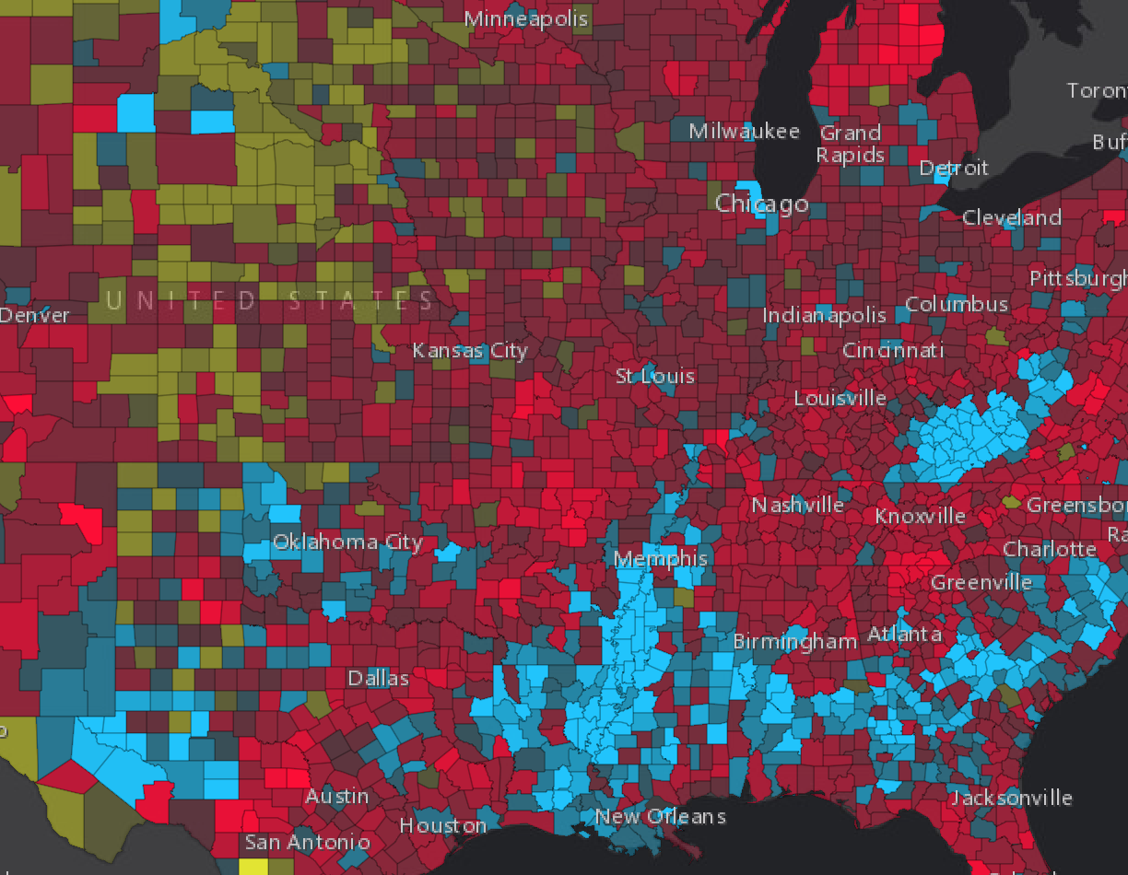
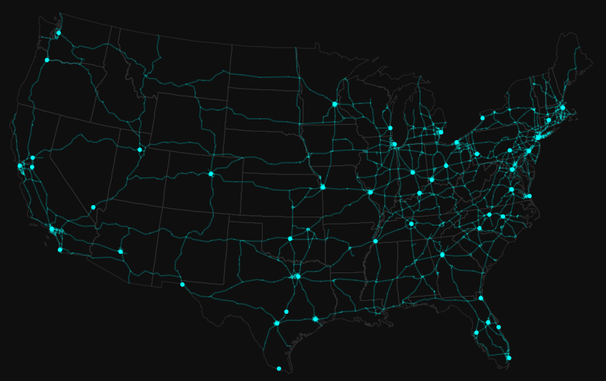
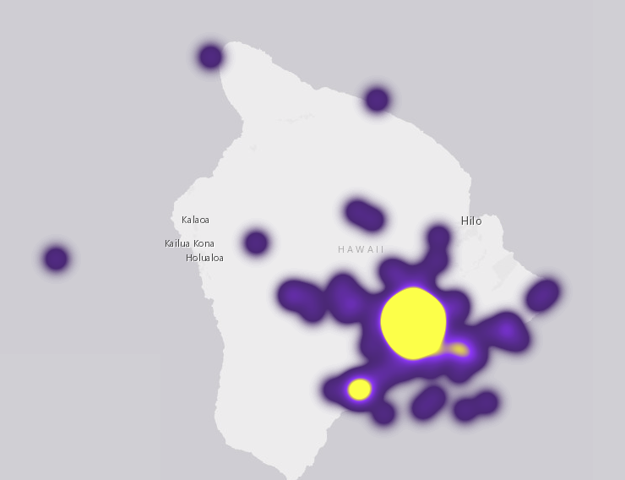
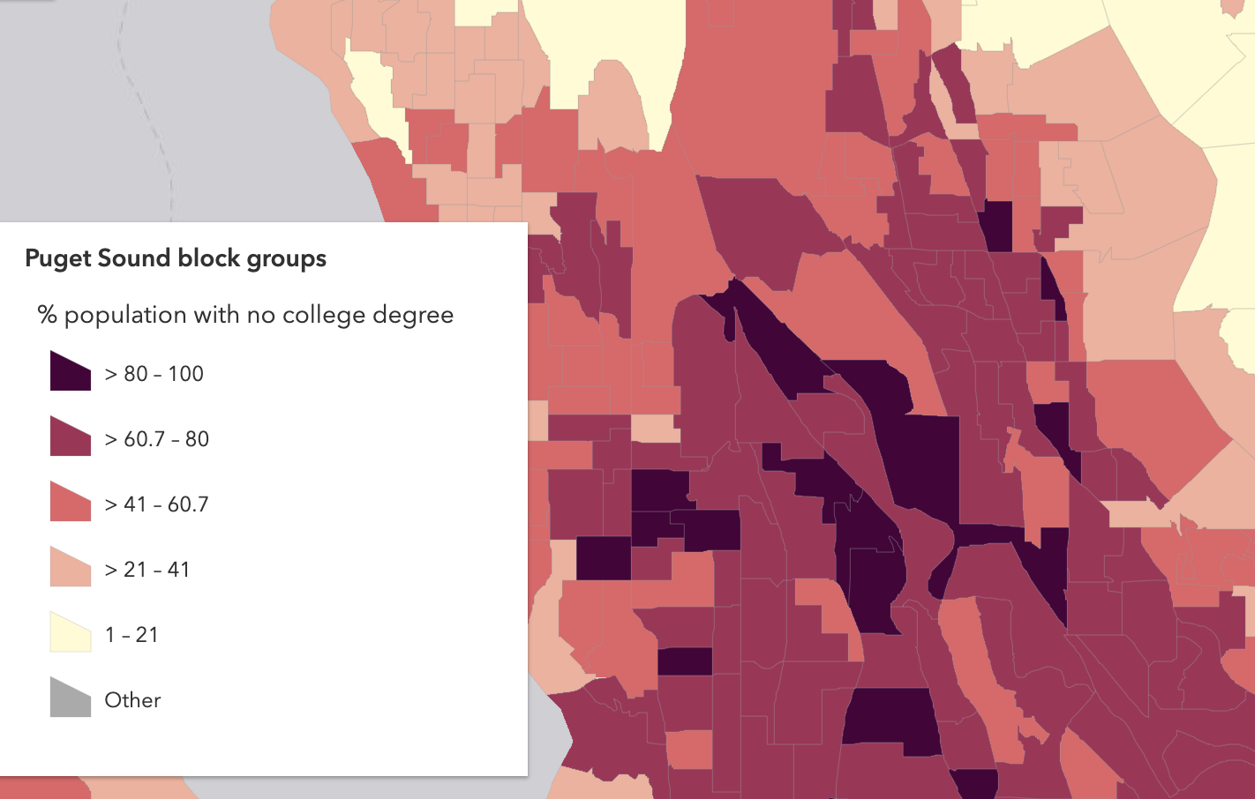
Renderers
UniqueValueRenderer
SimpleRenderer
HeatmapRenderer
ClassBreaksRenderer

Slide 14
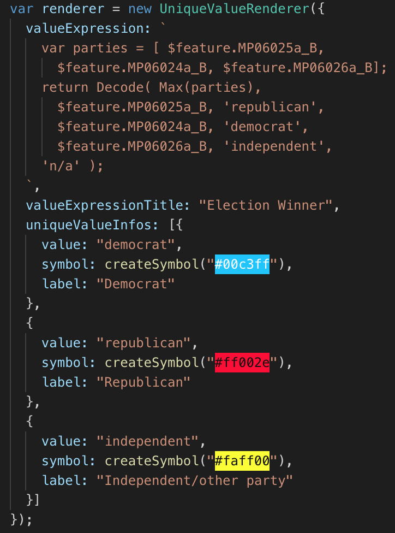
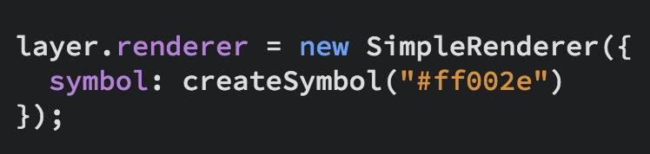
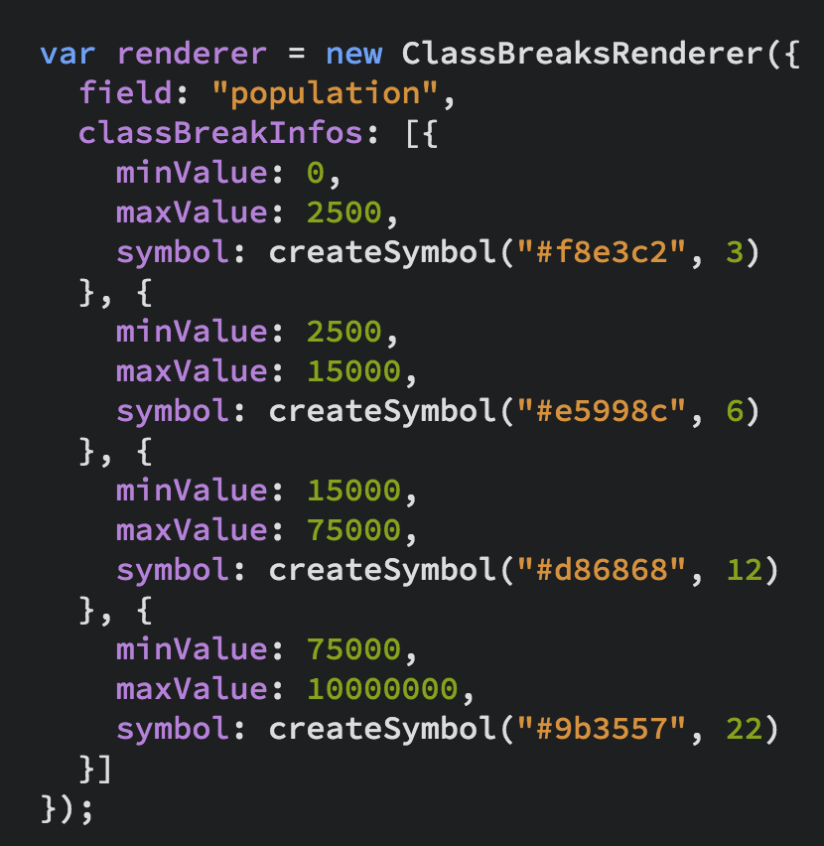
UniqueValueRenderer
Renderers
SimpleRenderer
ClassBreaksRenderer

Slide 15
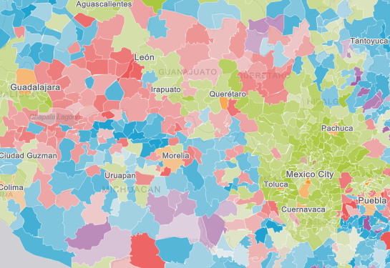
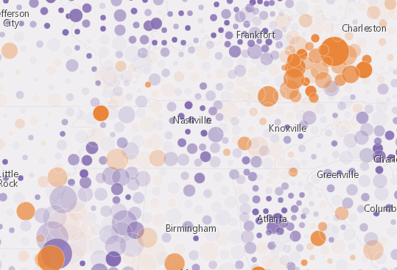
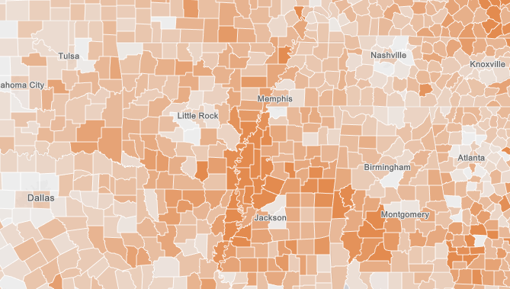
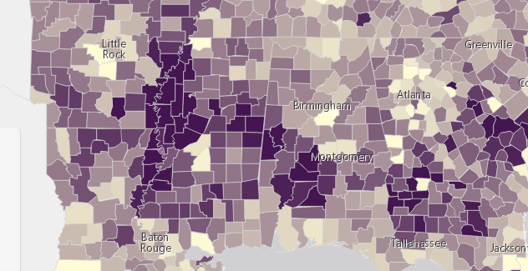
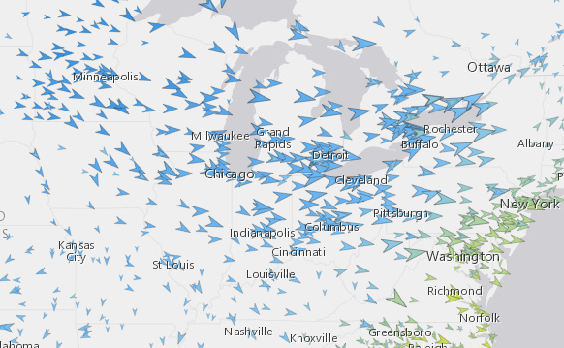
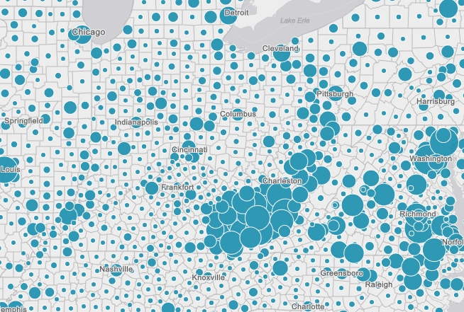
Renderers
Visual Variables
A property of the renderer
For numeric data-driven continuous visualizations
Color
Size
Opacity
Rotation

Slide 16
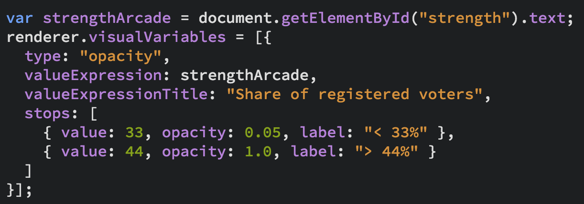
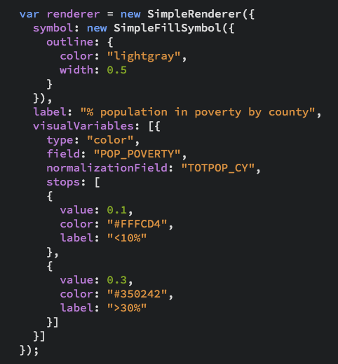
Renderers
Visual Variables

Slide 17
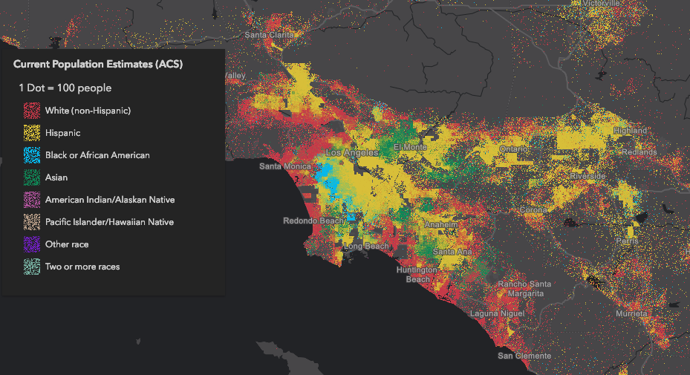
Dot Density

Slide 18
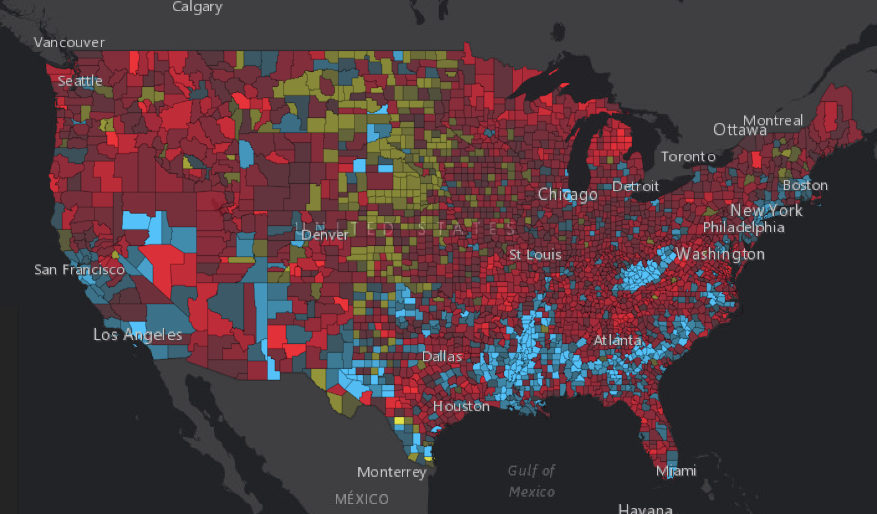

Examples
Political Party Affiliation

Slide 19
Symbol Size by Scale
ArcGIS blog: How and why to size symbols by scale in web maps

Slide 20
Smart Mapping

Slide 21
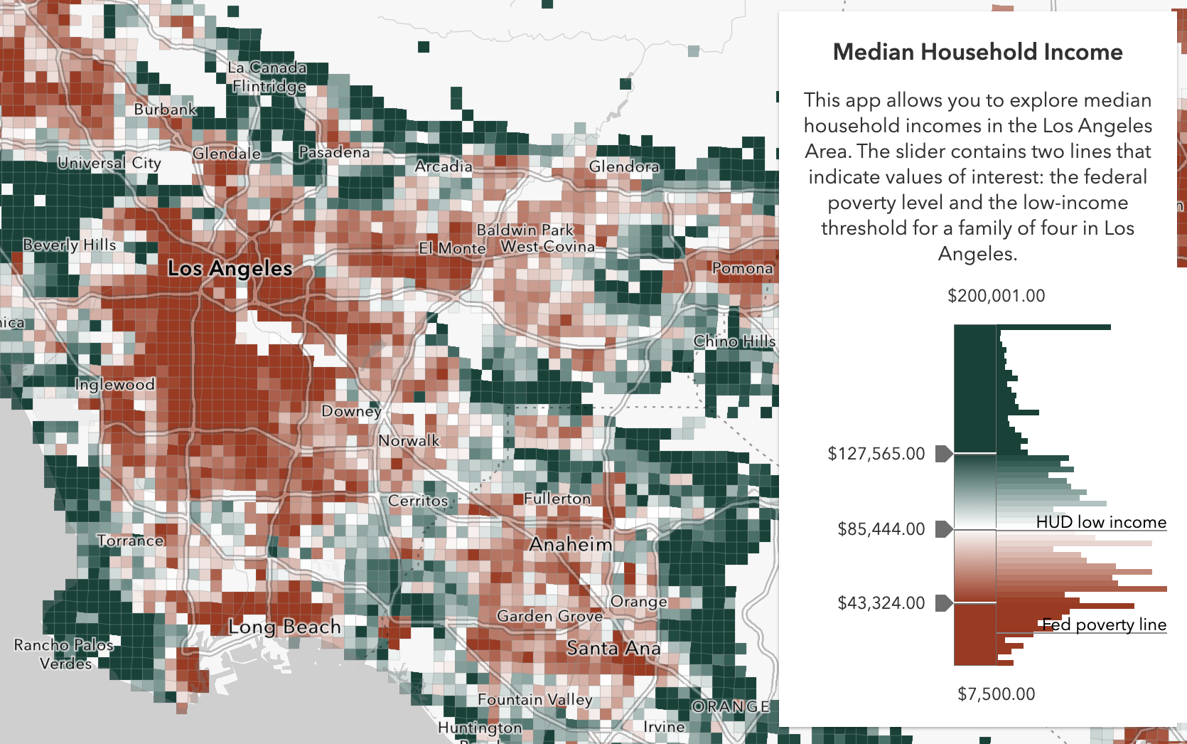
Smart Mapping
It’s all about…
Statistics - Which breaks/stop points make sense?
Color – What colors work best with my basemap? Should it be above and below or high to low?
Class breaks are hard

Slide 22
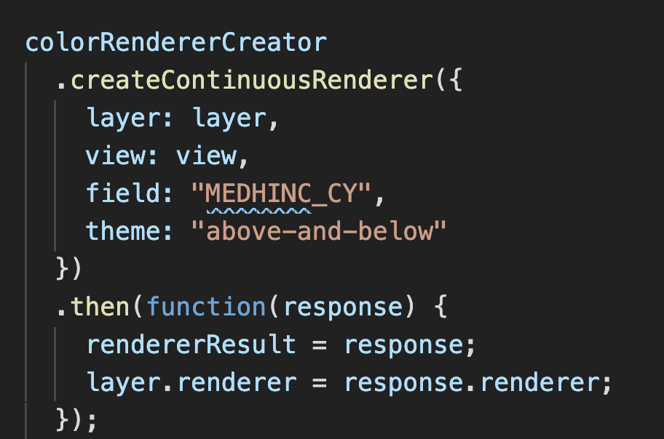
Smart Mapping

Slide 24
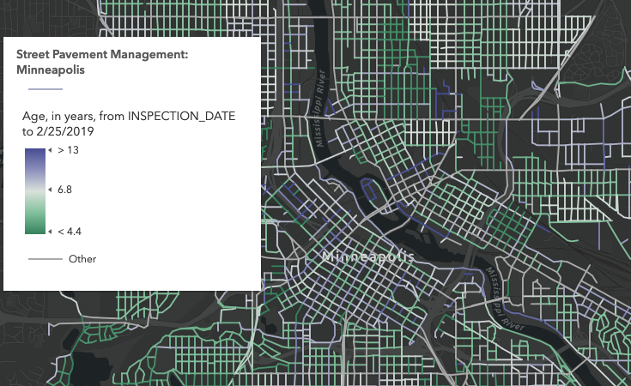
Age

Slide 25
Predominance

Slide 26
Relationship

Slide 27
Symbol Size by Scale
ArcGIS blog: How and why to size symbols by scale in web maps

Slide 28
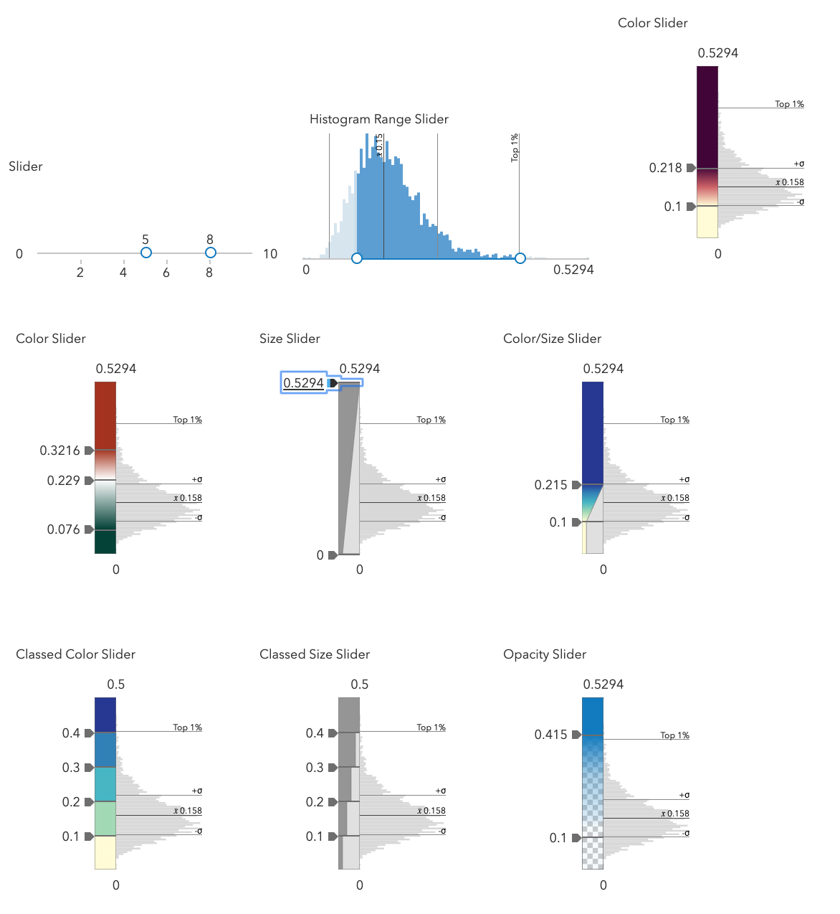
Smart Mapping Sliders

Slide 29
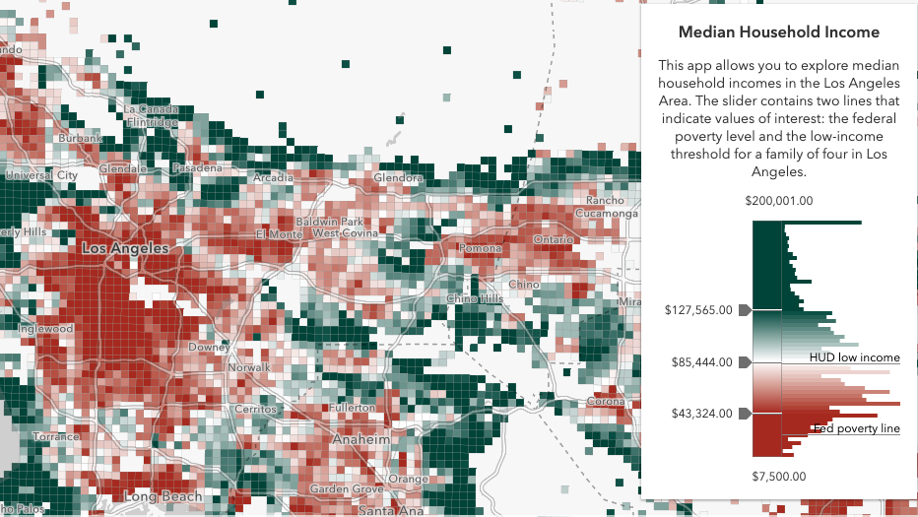
Data Exploration
Smart Mapping

Slide 30
Should I always use Smart Mapping? No!
When to use the Smart Mapping APIs
Data exploration
Renderer authoring
Represent unknown statistical data that updates frequently
Statistic queries
When not to use the Smart Mapping APIs
You know your data well
You use standardized colors or determined by organization
You can author your style in ArcGIS Online or ArcGIS Enterprise portal
Just because

Slide 31
OK. I shouldn’t use the Smart Mapping APIs... but I still need help with my cartography. What should I do?
You can author your style in ArcGIS Online or ArcGIS Enterprise portal and take advantage of everything Smart Mapping has to offer.
Read the Data Visualization guide pages!
Esri color ramps
Data visualization best practices

Slide 32
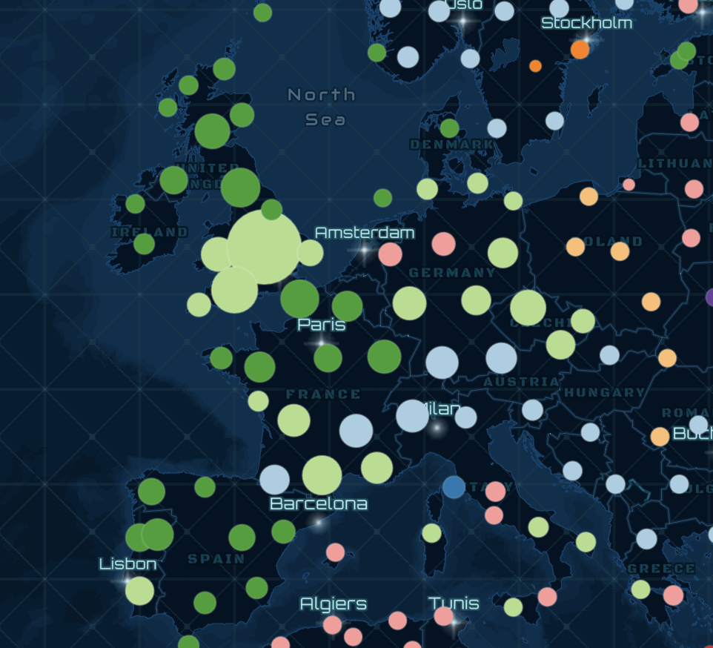
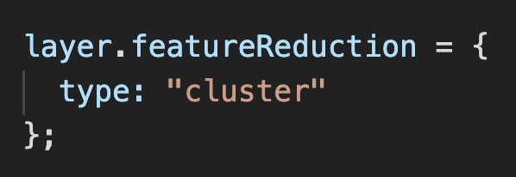
Clustering
FeatureReductionCluster

Slide 33
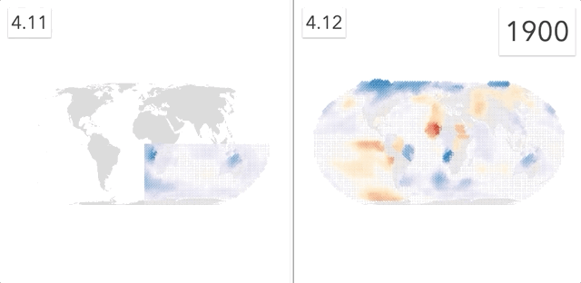
Faster visual updates
WebGL rendering

Slide 34
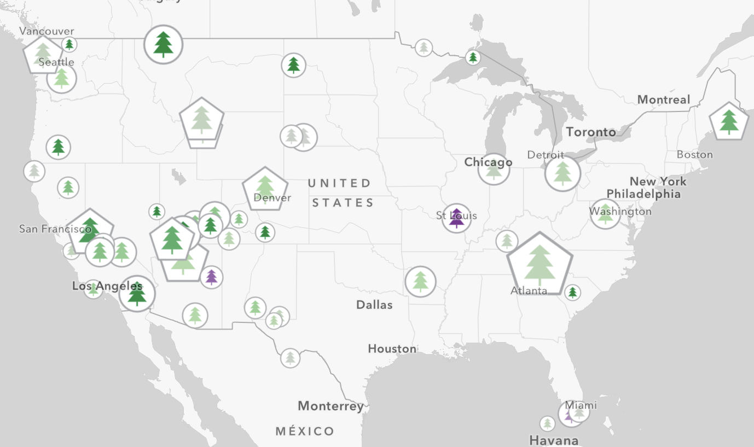
Web Styles, CIM, client-side processing

Slide 35
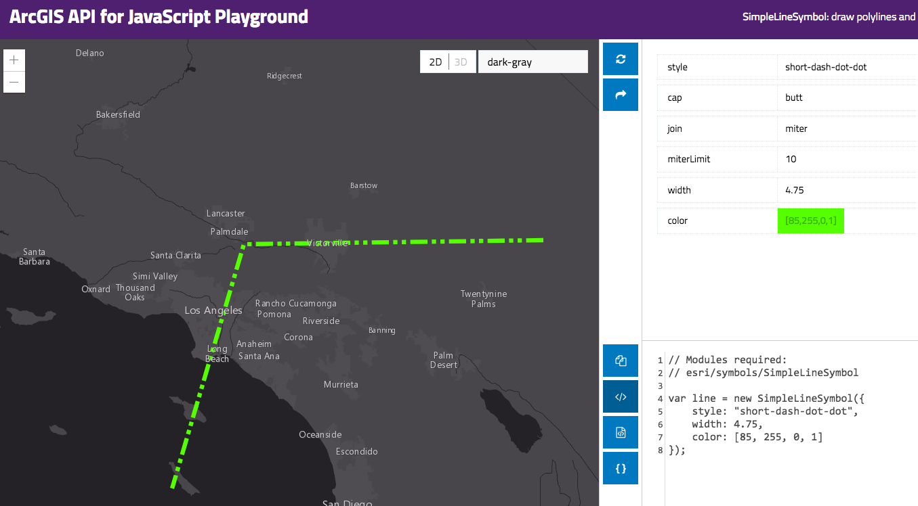
Resources
Get started with visualization
ArcGIS Blog
Visualization Samples
Documentation
Renderer
Symbol

Slide 36


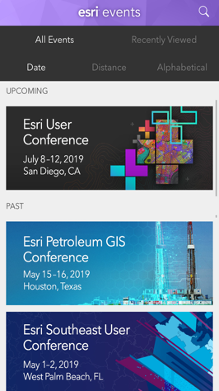
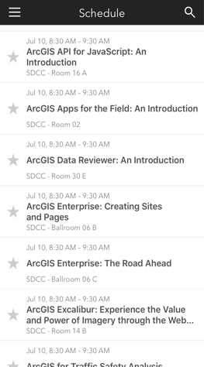

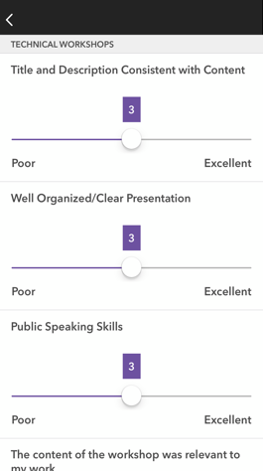




Please Share Your Feedback in the App
Download the Esri Events app and find your event
Select the session you attended
Scroll down to “Survey”
Log in to access the survey
Complete the survey and select “Submit”
Notes:
Guidance:
This is the survey slide. You can use the example as is or you can screenshot your session.

Slide 37


